Slide 1
Bean Scopes

Slide 2

Learning Outcome
After completing this video, you will learn:
Spring MVC
MVC Bean Scopes
Types of Bean Scopes
Configuration of Scopes

Slide 3
Spring Beans
Recap

Slide 4
Spring Beans
Overview
A Bean is a POJO(Plain Old Java Object), which is managed by the spring container.
When you create a bean definition what you are creating is a recipe for creating actual instances of the class defined by that bean definition.
The idea that a bean definition is a recipe is important, because it means that, just like a class, you can potentially have many object instances created from a single recipe.
Objects created by the container are also called managed objects or beans.

Slide 5
Bean Scopes
A recipe for class instances

Slide 6
Bean Scopes
Overview
Creating a bean definition is a recipe for creating actual instances of the class defined by that bean definition.
When defining a <bean> you have the option of declaring a scope for that bean.
For example, to force Spring to produce a new bean instance each time one is needed, you should declare the bean's scope attribute to be prototype.
Similarly, if you want Spring to return the same bean instance each time one is needed, you should declare the bean's scope attribute to be singleton.
Notes:
The idea that bean definition is a recipe is important, because it means that, just like a class, you can potentially have many object instances created from a single recipe.
You can control not only the various dependencies and configuration values that are to be plugged into an object that is created from a particular bean definition, but also the scope of the objects created from a particular bean definition.
This approach is very powerful and gives you the flexibility to choose the scope of the objects you create through configuration instead of having to 'bake in' the scope of an object at the Java class level.

Slide 7
Bean Scopes
Types
The Spring Framework supports the following five scopes:
Scope | Description
singleton | Scopes a single bean definition to a single object instance per Spring IoC container.
prototype | Scopes a single bean definition to any number of object instances.
request | Scopes a single bean definition to the lifecycle of a single HTTP request; that is each and every HTTP request will have its own instance of a bean created off the back of a single bean definition. Only valid in the context of a web-aware Spring ApplicationContext.
session | Scopes a single bean definition to the lifecycle of a HTTP Session. Only valid in the context of a web-aware Spring ApplicationContext.
global session | Scopes a single bean definition to the lifecycle of a global HTTP Session. Typically, only valid when used in a portlet context. Only valid in the context of a web-aware Spring ApplicationContext.
Notes:
Beans can be defined to be deployed in one of a number of scopes: out of the box, the Spring Framework supports exactly five scopes (of which three are available only if you are using a web-aware ApplicationContext).

Slide 8
Bean Scopes
Singleton Scope
When a bean is a singleton, only one shared instance of the bean will be managed.
The Spring IoC container will create exactly one instance of the object defined by that bean definition.
This single instance will be stored in a cache of such singleton beans.
All subsequent requests and references for that named bean will result in the cached object being returned.
Notes:
All requests for beans with an id or ids matching that bean definition will result in that one specific bean instance being returned by the Spring container.
To put it another way, when you define a bean definition and it is scoped as a singleton, then the Spring IoC container will create exactly one instance of the object defined by that bean definition. This single instance will be stored in a cache of such singleton beans, and all subsequent requests and references for that named bean will result in the cached object being returned.

Slide 9
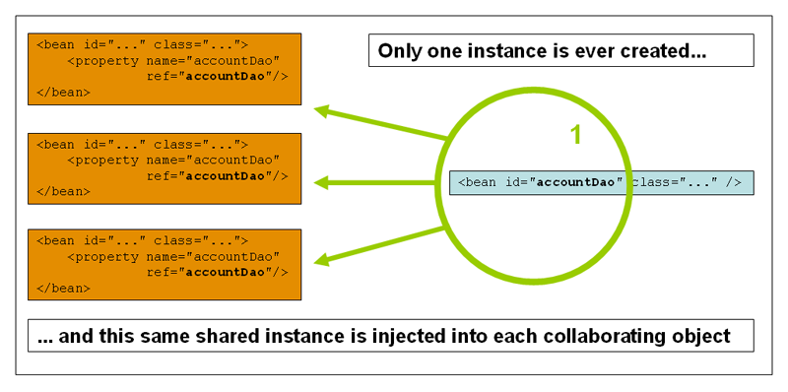
Bean Scopes
Singleton Scope
Notes:
Spring's concept of a singleton bean is quite different from the Singleton pattern as defined in the seminal Gang of Four (GoF) patterns book. The GoF Singleton hard codes the scope of an object such that one and only one instance of a particular class will ever be created per ClassLoader. The scope of the Spring singleton is best described as per container and per bean. This means that if you define one bean for a particular class in a single Spring container, then the Spring container will create one and only one instance of the class defined by that bean definition. The singleton scope is the default scope in Spring.

Slide 10
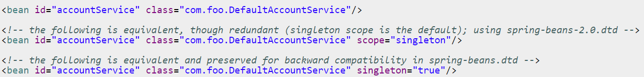
Bean Scopes
Singleton Scope
To define a bean as a singleton in XML, you would write configuration like so:

Slide 11
Bean Scopes
Prototype Scope
Prototype scope of bean deployment results in the creation of a new bean instance every time a request for that specific bean is made.
it is injected into another bean, or it is requested via a programmatic getBean() method call on the container
Notes:
The non-singleton, prototype scope of bean deployment results in the creation of a new bean instance every time a request for that specific bean is made (that is, it is injected into another bean or it is requested via a programmatic getBean() method call on the container). As a rule of thumb, you should use the prototype scope for all beans that are stateful, while the singleton scope should be used for stateless beans.

Slide 12
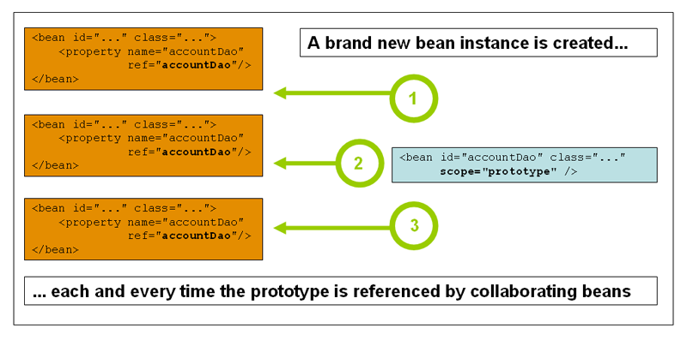
Bean Scopes
Prototype Scope
Notes:
The following diagram illustrates the Spring prototype scope.
Note that a DAO would not typically be configured as a prototype, since a typical DAO would not hold any conversational state.

Slide 13
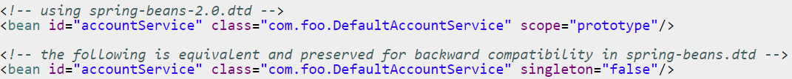
Bean Scopes
Prototype Scope
To define a bean as a prototype in XML, you would write configuration like so:
Notes:
There is one quite important thing to be aware of when deploying a bean in the prototype scope, in that the lifecycle of the bean changes slightly. Spring does not manage the complete lifecycle of a prototype bean: the container instantiates, configures, decorates and otherwise assembles a prototype object, hands it to the client and then has no further knowledge of that prototype instance.
In some respects, you can think of the Spring container's role when talking about a prototype-scoped bean as somewhat of a replacement for the Java 'new' operator. All lifecycle aspects past that point have to be handled by the client.

Slide 14
Bean Scopes
The Other Scopes
The other scopes, namely request, session, and global session are for use only in web-based applications.
The request scope: When the request is finished processing, the bean that is scoped to the request will be discarded.
The session scope: When the HTTP Session is eventually discarded, the bean that is scoped to that particular HTTP Session will also be discarded.
The global scope: Beans defined at the global session scope are scoped (or bound) to the lifetime of the global portlet Session.
Notes:
The other scopes, namely request, session, and global session are for use only in web-based applications (and can be used irrespective of which particular web application framework you are using, if indeed any).
The global session scope is similar to the standard HTTP Session scope, and really only makes sense in the context of portlet-based web applications. Please note that if you are writing a standard Servlet-based web application and you define one or more beans as having global session scope, the standard HTTP Session scope will be used, and no error will be raised.
These scopes are only available if you are using a web-aware Spring ApplicationContext implementation (such as XmlWebApplicationContext). If you try using these next scopes with regular Spring IoC containers such as the XmlBeanFactory or ClassPathXmlApplicationContext, you will get an IllegalStateException complaining about an unknown bean scope.

Slide 15

Quick Question
Beans defined in the spring framework are by default ______?
​
A. Abstract
B. Singleton
C. Final
D. Initialized

Slide 16
Quick Question
Beans defined in the spring framework are by default ______?
​
A. Abstract
B. Singleton√
C. Final
D. Initialized

Slide 17

Summary
This video gave a brief description of:
Bean scopes.
The types of bean scopes.
Basic usage of different scopes.

Slide 18

Thank You!

